Slide 1

Chemical Kinetics
Understanding the Speed and Mechanism of Chemical Reactions

Slide 2
Why Study Chemical Kinetics?
"Chemistry, by its very nature, is concerned with change. Substances with well defined properties are converted by chemical reactions into other substances with different properties."
Chemical kinetics helps us understand how chemical reactions occur by studying their rates and mechanisms. It answers crucial questions like:
How rapidly does food spoil?
How fast does fuel burn in an engine?
How to design rapidly setting dental fillings?

Slide 3





Key Objectives
Reaction Rates
Reaction Types
Rate Constants
Define and express average and instantaneous reaction rates.
Distinguish between elementary and complex reactions.
Define and determine rate constants for various reactions.
Influencing Factors
Collision Theory
Discuss dependence of reaction rates on concentration, temperature, and catalysts.
Understand how molecules collide to react effectively.

Slide 4


Defining Reaction Rate
The rate of a reaction is the change in concentration of a reactant or product per unit time.
Rate of Disappearance of Reactant (R)
Rate of Appearance of Product (P)
Since reactant concentration decreases, a negative sign ensures the rate is positive.
Product concentration increases over time.
Units of rate are typically mol L-1s-1 or atm s-1 for gaseous reactions.

Slide 5
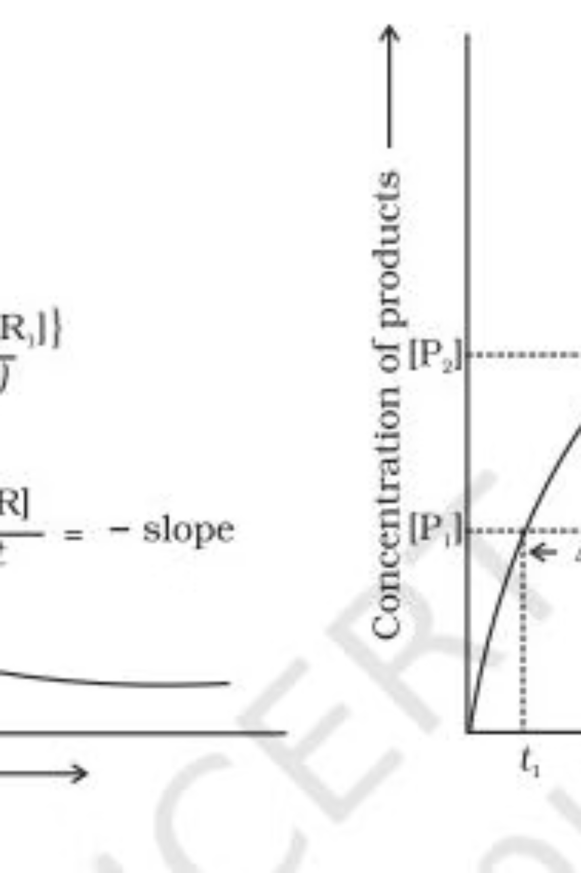
Average vs. Instantaneous Rate
Average Rate
Instantaneous Rate
Calculated over a specific time interval. It shows the overall change but doesn't reflect the rate at any single moment.
The rate at a particular moment in time, obtained by considering the average rate over an infinitesimally small time interval ( dt).
Example: For C₄H₉Cl hydrolysis, the average rate falls from 1.90 × 10⁻⁴ mol L⁻¹s⁻¹ to 0.4 × 10⁻⁴ mol L⁻¹s⁻¹ over time.
Determined graphically by the slope of a tangent on a concentration vs. time plot.

Slide 6



Factors Influencing Reaction Rate
Concentration
Temperature
Catalyst
Higher reactant concentration generally leads to faster reaction rates. This relationship is defined by the rate law.
Increasing temperature typically accelerates reactions, often doubling the rate constant for every 10°C rise.
Catalysts increase reaction rates without being consumed, by providing alternative reaction pathways with lower activation energy.

Slide 7
Order and Molecularity of a Reaction
Order of a Reaction
Molecularity of a Reaction
Sum of the powers of reactant concentrations in the rate law expression.
Number of reacting species that must collide simultaneously in an elementary reaction.
Determined experimentally, not from stoichiometry.
Always a whole number (1, 2, or 3).
Can be 0, 1, 2, 3, or even a fraction.
Applicable only to elementary reactions.
Applicable to both elementary and complex reactions.
For complex reactions, molecularity has no meaning; the overall rate is controlled by the slowest step (rate-determining step).

Slide 8
Integrated Rate Equations
These equations relate reactant concentrations at different times to the rate constant, simplifying experimental data analysis.
Zero
R → P
d[R]/dt = -k
kt = [R]₀ - [R]
[R]₀ / 2k
First
R → P
d[R]/dt = -k[R]
kt = ln{[R]₀ / [R]}
0.693 / k
Pseudo First Order Reactions: Reactions that appear first order due to one reactant being in large excess (e.g., hydrolysis of ethyl acetate).

Slide 9
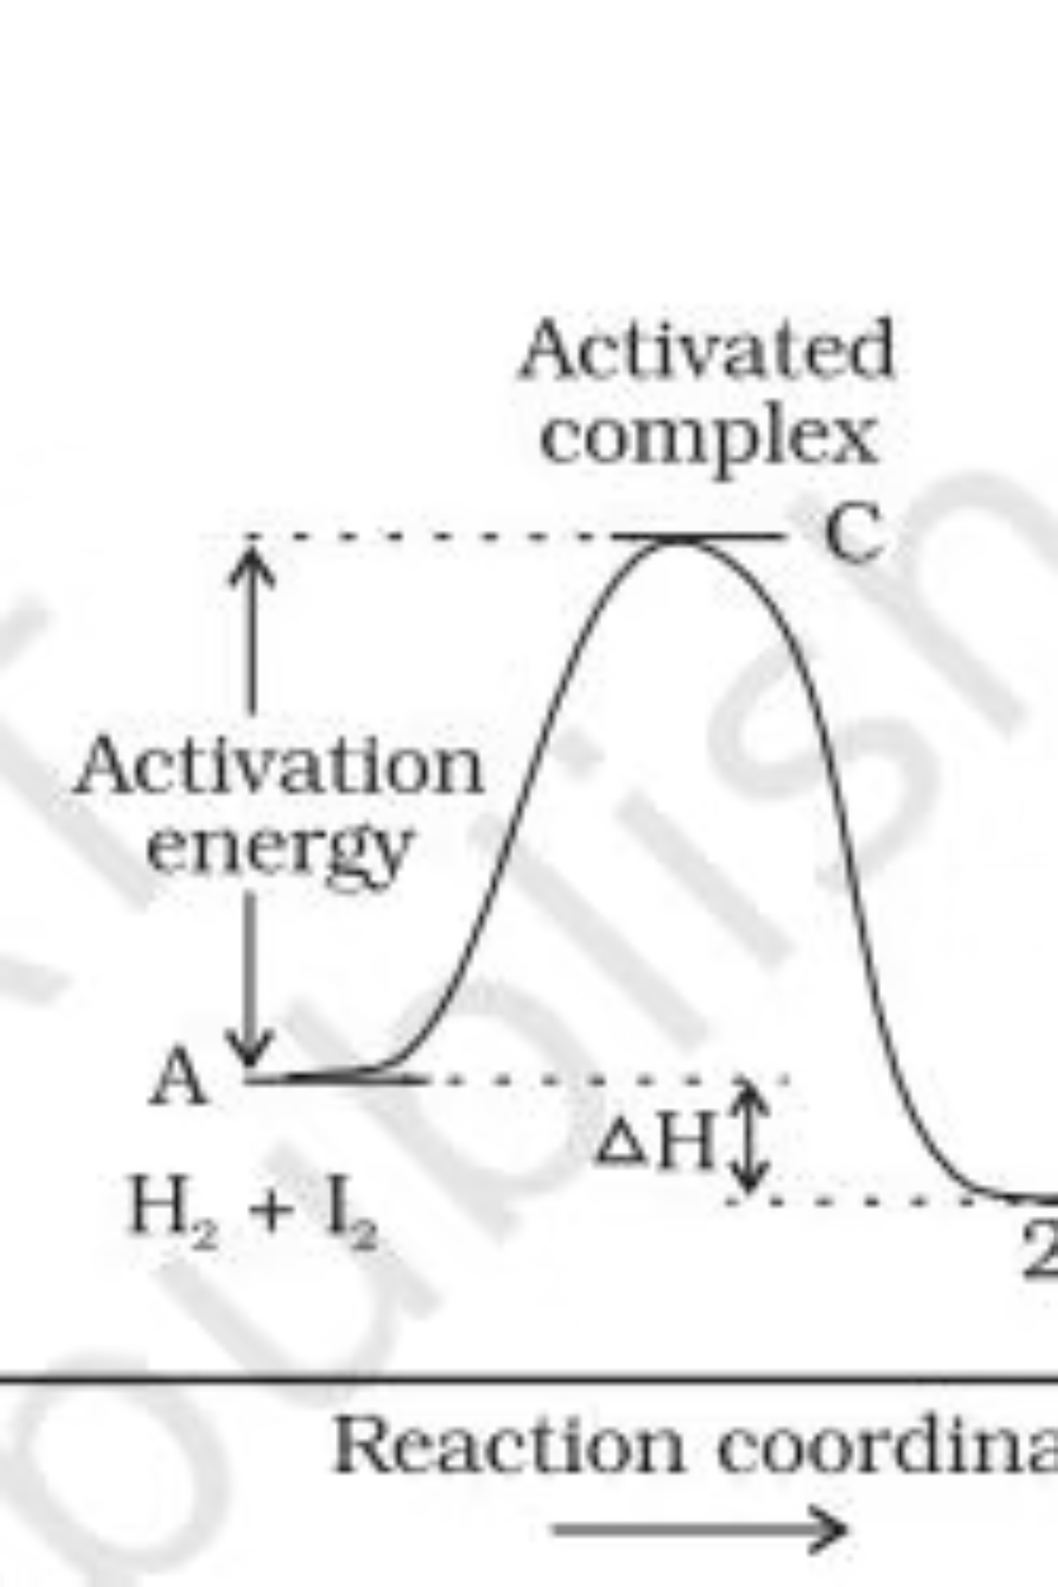
Temperature Dependence: Arrhenius Equation
The Arrhenius equation quantifies the effect of temperature on reaction rates:
k: Rate constant
A: Arrhenius factor (frequency factor)
Ea: Activation energy (minimum energy for reaction)
R: Gas constant
T: Absolute temperature
Increasing temperature or decreasing activation energy leads to a faster reaction rate. Catalysts lower activation energy, speeding up reactions.

Slide 10
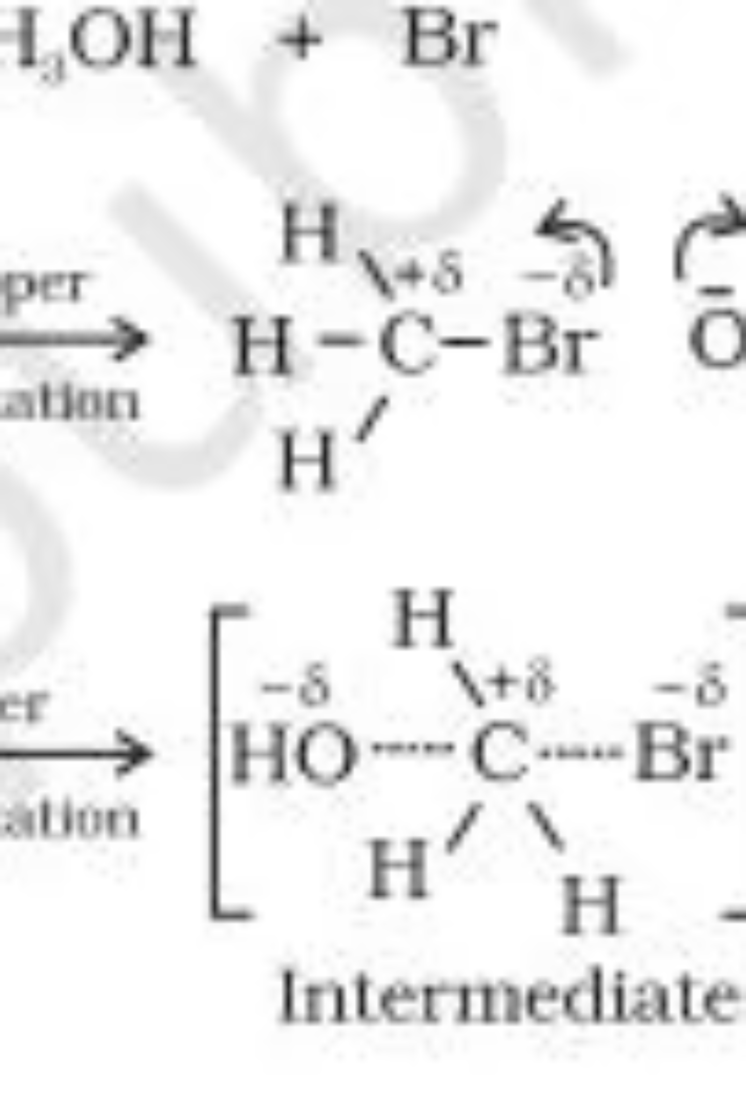
Collision Theory
Developed by Max Trautz and William Lewis, this theory explains reaction rates based on molecular collisions.
Collision Frequency (Z)
Number of collisions per second per unit volume.
Effective Collisions
Collisions must have sufficient kinetic energy (threshold energy) and proper orientation to form products.
Steric Factor (P)
Accounts for the requirement of proper molecular orientation during collision.
Rate = P ZAB e-Ea/RT

